Slide 1
Windows SDK

Slide 2
Networking Development
Windows Sockets API
WinHTTP And WinINET
System Services Development
Memory Management API
Process And Threads
File And Storage

Slide 3
Networking Development

Slide 4
Windows Sockets (Winsock) API
Windows Sockets 2 (Winsock) enables programmers to create advanced Internet, intranet, and other network-capable applications to transmit application data across the wire, independent of the network protocol being used. With Winsock, programmers are provided access to advanced Microsoft® Windows® networking capabilities such as multicast and Quality of Service (QoS).

Slide 5
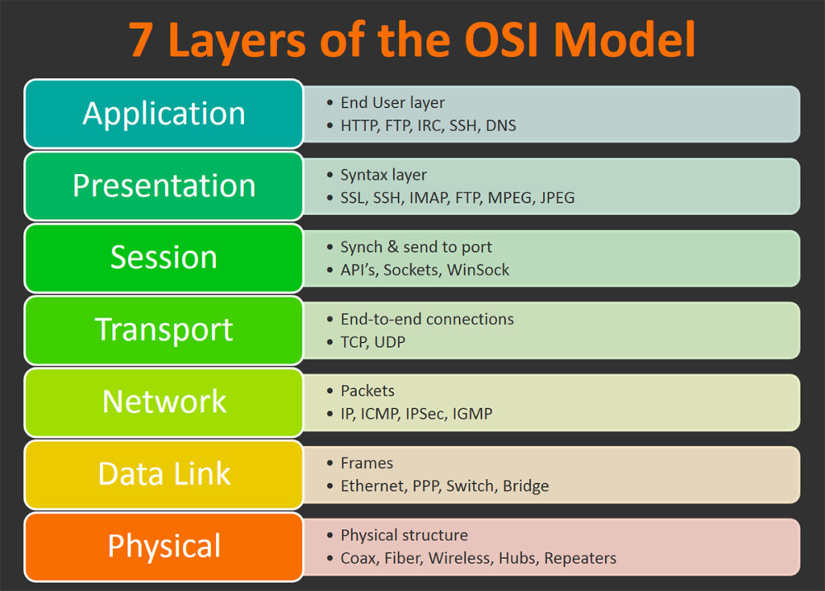
OSI（Open System Interconnect）:
That is, open system interconnection . Commonly referred to as the OSI reference model, it is a network interconnection model developed by the ISO organization in 1985.In order to make network application more popular, ISO introduced the OSI reference model . The implication is that it is recommended that all companies use this specification to control the network . So all the companies have the same specifications, and they can connect.

Slide 6
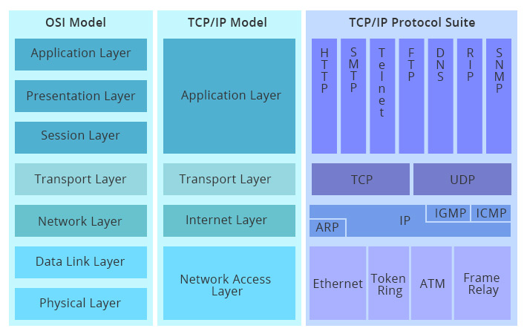
4 layer of the TCP/IP model:

Slide 7
Application Layer:
The application layer is the OSI layer closest to the end user, which means both the OSI application layer and the user interact directly with the software application. This layer interacts with software applications that implement a communicating component. Such application programs fall outside the scope of the OSI model. Application-layer functions typically include identifying communication partners, determining resource availability, and synchronizing communication. When identifying communication partners, the application layer determines the identity and availability of communication partners for an application with data to transmit. The most important distinction in the application layer is the distinction between the application-entity and the application. For example, a reservation website might have two application-entities: one using HTTP to communicate with its users, and one for a remote database protocol to record reservations. Neither of these protocols have anything to do with reservations. That logic is in the application itself. The application layer per se has no means to determine the availability of resources in the network.

Slide 8
Transport Layer :
The transport layer provides the functional and procedural means of transferring variable-length data sequences from a source to a destination host, while maintaining the quality of service functions.
The transport layer controls the reliability of a given link through flow control, segmentation/ desegmentation, and error control. Some protocols are state- and connection-oriented. This means that the transport layer can keep track of the segments and re-transmit those that fail delivery. The transport layer also provides the acknowledgement of the successful data transmission and sends the next data if no errors occurred. The transport layer creates segments out of the message received from the application layer. Segmentation is the process of dividing a long message into smaller messages.

Slide 9
Network Layer:
The network layer provides the functional and procedural means of transferring variable length data sequences (called packets) from one node to another connected in "different networks". A network is a medium to which many nodes can be connected, on which every node has an address and which permits nodes connected to it to transfer messages to other nodes connected to it by merely providing the content of a message and the address of the destination node and letting the network find the way to deliver the message to the destination node, possibly routing it through intermediate nodes. If the message is too large to be transmitted from one node to another on the data link layer between those nodes, the network may implement message delivery by splitting the message into several fragments at one node, sending the fragments independently, and reassembling the fragments at another node. It may, but does not need to, report delivery errors.

Slide 10
Data Link Layer:
The data link layer provides node-to-node data transfer—a link between two directly connected nodes. It detects and possibly corrects errors that may occur in the physical layer. It defines the protocol to establish and terminate a connection between two physically connected devices. It also defines the protocol for flow control between them.

Slide 11
Physical Layer:
The physical layer is responsible for the transmission and reception of unstructured raw data between a device and a physical transmission medium. It converts the digital bits into electrical, radio, or optical signals. Layer specifications define characteristics such as voltage levels, the timing of voltage changes, physical data rates, maximum transmission distances, and physical connectors. This includes the layout of pins, voltages, line impedance, cable specifications, signal timing and frequency for wireless devices. Bit rate control is done at the physical layer and may define transmission mode as simplex, half duplex, and full duplex. The components of a physical layer can be described in terms of a network topology. Bluetooth, Ethernet, and USB all have specifications for a physical layer.

Slide 12
Transmission Control Protocol (TCP)：
TCP (Transmission Control Protocol) is a connection-oriented, reliable, terrapid-based Transmission layer communication Protocol, defined by RFC 793 of IETF.In the simplified computer network OSI model, which performs the functions specified by the fourth transport layer, the user datagram protocol (UDP) is another important transport protocol within the same layer [1].In the Internet protocol suite, the TCP layer is an intermediate layer that sits above the IP layer and below the application layer.Reliable pipe-like connections between application layers of different hosts are often required, but the IP layer does not provide such a flow mechanism, but rather provides unreliable packet switching.

Slide 13
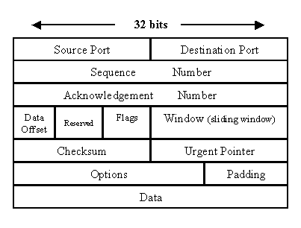
TCP message structure

Slide 14
Source port: Sender application using ports.
Destination port: Receiver applications use ports.
Sequence Number And Acknowledgement Number: Sequence number and response number are two very important fields used by TCP protocol to establish reliable transmission.
Data Offset: Because the length of the Options field is not fixed, the field is required to indicate the offset.
Reserved: Reserved bit, set to 0.
Flags: Flag bit, used to identify the type of message.
Window: Sliding window to limit transmission rate.
Checksum: Before the data is sent out by the sender, a check action is performed and the check value of the action is marked on this field.
Urgent Pointer: The Flags field will not take effect until 1, which is used to locate the emergency data.

Slide 15
Options: Optional information, commonly MSS（Maximum Segment Size）.
Padding：Fill in bits to make the Options field complete 32 bits.
Data：Data to be sent from the application layer.

Slide 16
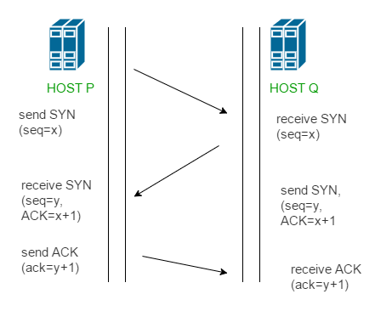
three-way handshaking
four-way handshake

Slide 17
Sockets and TCP/IP:
Sockets are generally, but not exclusively, used in conjunction with the Transmission Control Protocol/Internet Protocol (TCP/IP) that dominates Internet communications. The Internet Protocol (IP) part of TCP/IP involves packaging data into "datagrams" that contain header information to identify the source and destination of the data. The Transmission Control Protocol (TCP) provides a means of reliable transport and error checking for the IP datagrams.
Within TCP/IP, a communication endpoint is defined by an IP address and a port number. The IP address consists of 4 bytes that identify a server on the Internet. The IP address is generally shown in "dotted quad" format, with decimal numbers separated by periods, for example "209.86.105.231". A port number identifies a particular service or process that the server provides. Some of these port numbers are standardized to provide well−known services.
When a socket is used with TCP/IP, a socket is the TCP/IP communication endpoint. Thus, the socket specifies an IP address and a port number.

Slide 18
typedef struct WSAData {
WORD wVersion;
WORD wHighVersion;
unsigned short iMaxSockets;
unsigned short iMaxUdpDg;
char *lpVendorInfo;
char szDescription[WSADESCRIPTION_LEN + 1];
char szSystemStatus[WSASYS_STATUS_LEN + 1];
} WSADATA;
The WSADATA structure contains information about the Windows Sockets implementation.
int WSAStartup(
WORD wVersionRequired,
LPWSADATA lpWSAData
);
The WSAStartup function initiates use of the Winsock DLL by a process.
wVersionRequired: Specify the winsock version to use
lpWSAData: A pointer to the WSAData data structure that is to receive details of the Windows Sockets implementation.

Slide 19
SOCKET WSAAPI socket(
int af,
int type,
int protocol
);
af: address family(AF_INET, AF_INET6, AF_UNSPEC…)
type: The type specification for the new socket.(SOCK_STREAM, SOCK_DGRAM, SOCK_RAW…)
protocol: The protocol to be used.(IPPROTO_TCP, IPPROTO_UDP…)
int bind(
SOCKET s,
const sockaddr *addr,
int namelen
);
s: A descriptor identifying an unbound socket.
addr: A pointer to the sockaddr structure.
namelen: The length, in bytes, of the value pointed to by the name parameter.

Slide 20
int WSAAPI listen(
SOCKET s,
int backlog
);
s: A descriptor identifying a bound, unconnected socket.
backlog: The maximum length of the queue of pending connections.
SOCKET WSAAPI accept(
SOCKET s,
sockaddr *addr,
int *addrlen
);
s: A descriptor that identifies a socket that has been placed in a listening state with the listen function. The connection is actually made with the socket that is returned by accept.
addr: An optional pointer to a buffer that receives the address of the connecting entity, as known to the communications layer. The exact format of the addr parameter is determined by the address family that was established when the socket from the sockaddr structure was created.
addrlen: An optional pointer to an integer that contains the length of structure pointed to by the addr parameter.

Slide 21
int recv(
SOCKET s,
char *buf,
int len,
int flags
);
s: The descriptor that identifies a connected socket.
buf: A pointer to the buffer to receive the incoming data.
len: The length, in bytes, of the buffer pointed to by the buf parameter.
flags: A set of flags that influences the behavior of this function.
int WSAAPI send(
SOCKET s,
const char *buf,
int len,
int flags
);
s: A descriptor identifying a connected socket.
buf: A pointer to a buffer containing the data to be transmitted.
len: The length, in bytes, of the data in buffer pointed to by the buf parameter.
flags: A set of flags that specify the way in which the call is made. This parameter is constructed by using the bitwise OR operator with any of the following values.

Slide 22
int WSAAPI connect(
SOCKET s,
const sockaddr *name,
int namelen
);
s: A descriptor identifying an unconnected socket.
name: A pointer to the sockaddr structure to which the connection should be established.
namelen: The length, in bytes, of the sockaddr structure pointed to by the name parameter.
Example: socket.sln

Slide 23
WinHTTP And WinINET
The Microsoft Windows Internet (WinINet) application programming interface (API) enables applications to access standard Internet protocols, such as FTP and HTTP. For ease of use, WiMicrosoft Windows HTTP Services (WinHTTP) provides
Developers with an HTTP client application programming interface (API) to send requests through the HTTP protocol to other HTTP servers.nINet abstracts these protocols into a high-level interface.

Slide 24
Hypertext Transfer Protocol(HTTP):
HTTP (HyperText Transfer Protocol) is the most widely used network Protocol on the Internet. All WWW files must comply with this standard. HTTP was originally designed to provide a way to publish and receive HTML pages. In 1960 Ted Nelson, an American, came up with a way to process text messages by computer and called it hypertext, which became the basis for the development of the HTTP hypertext transport protocol (HTTP) standard architecture. Ted Nelson coordinated a study by the World Wide Web Consortium and the Internet Engineering Task Force that resulted in a series of RFCS, the famous RFC 2616 defining HTTP 1.1.

Slide 25
A sample HTTP request:
GET /?id=233 HTTP/1.1
Host: localhost:8080
Connection: keep-alive
Upgrade-Insecure-Requests: 1
User-Agent: Mozilla/5.0 (Windows NT 10.0; Win64; x64) AppleWebKit/537.36 (KHTML, like Gecko) Chrome/72.0.3626.109 Safari/537.36
Accept: text/html,application/xhtml+xml,application/xml;q=0.9,image/webp,image/apng,*/*;q=0.8
Accept-Encoding: gzip, deflate, br
Accept-Language: zh-CN,zh;q=0.9,en;q=0.8
Request Line: The first line of the request message (GET /?id=233 HTTP/1.1). The request line has three fields: the method field, the URL field, and the HTTP version field. Method fields can take multiple values, all of which are defined. For example: GET, POST , HEAD, PUT, DELETE.
Most of the time we use GET and POST. The URL field is the identifier of the requested object.
The last field indicates the HTTP version used.

Slide 26
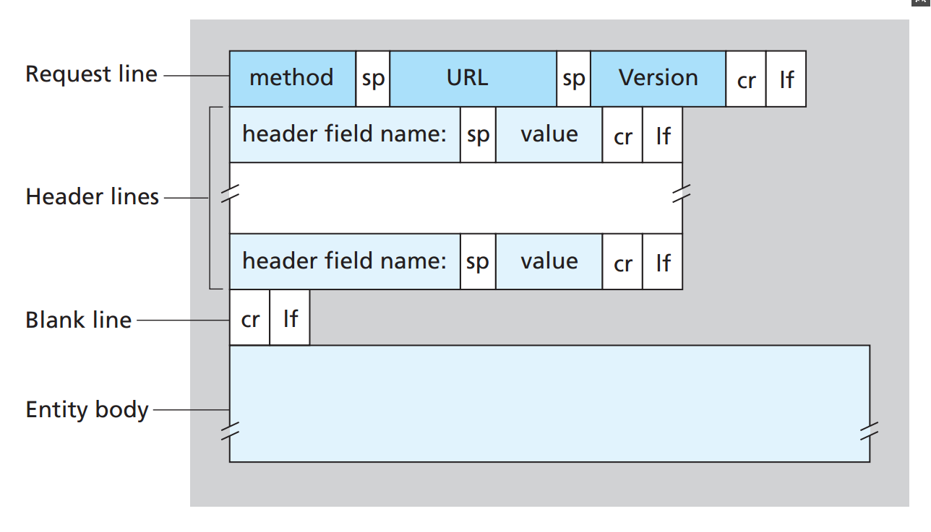
Header Line: The request header consists of key/value key pairs, one for each line, separated by a colon ":". The request header notifies the server of the request information on the client side. Typical request header:
User-Agent: The browser type that generates the request.
Accept: List of identifiable content types on the client side.
Host: The requested host name allows multiple domain names to share an IP address, the virtual host.
HTTP Request Message

Slide 27
A sample HTTP response:
HTTP/1.1 302
Cache-Control: private
Expires: Thu, 01 Jan 1970 00:00:00
GMT X-Content-Type-Options: nosniff
X-XSS-Protection: 1;
mode=block Strict-Transport-Security: max-age=31536000 ;
includeSubDomains X-Frame-Options: DENY
Location: https://www.dyzhello.club/login
Content-Length: 0
Date: Tue, 26 Feb 2019 07:41:27 GMT
Status Line: The first line of an HTTP response is called a status line, which has three fields: version, status code, and corresponding status information.
Header Line: Similar to the header of the request message. However, some fields are unique to the request message, while others are unique to the response message. Fields that can be adapted to both request and response messages are called generic header domains.

Slide 28
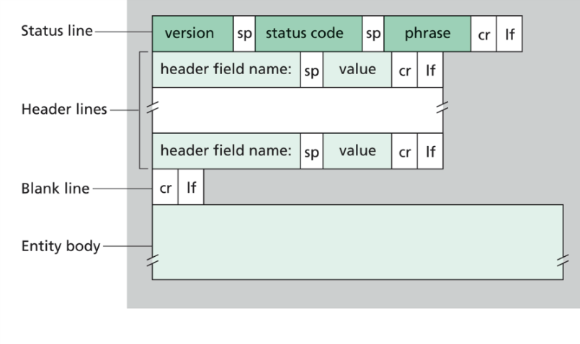
Entity Body: The data returned is usually an HTML or JSON string. Specific types should be indicated by Content-Type.
HTTP Response Message

Slide 29
void InternetOpen(
LPCSTR lpszAgent,
DWORD dwAccessType,
LPCSTR lpszProxy,
LPCSTR lpszProxyBypass,
DWORD dwFlags
);
InternetOpen: A handle is returned as the root handle to establish an HTTP or FTP connection.
lpszAgent: Pointer to a null-terminated string that specifies the name of the application or entity calling the WinINet functions. This name is used as the user agent in the HTTP protocol.
dwAccessType: Type of access required.
lpszProxy: Specifies the name of the proxy server(s) to use when proxy access is specified by settingdwAccessType to INTERNET_OPEN_TYPE_PROXY.
lpszProxyBypass: Host names or IP addresses that do not want to be sent to proxy servers can be added to the list of bypassed proxies.
dwFlags: Options. This parameter can be a combination of the following values.
INTERNET_FLAG_ASYNC、 INTERNET_FLAG_FROM_CACHE、 INTERNET_FLAG_OFFLINE

Slide 30
void InternetConnectA(
HINTERNET hInternet,
LPCSTR lpszServerName,
INTERNET_PORT nServerPort,
LPCSTR lpszUserName,
LPCSTR lpszPassword,
DWORD dwService,
DWORD dwFlags,
DWORD_PTR dwContext
);
InternetConnectA: Opens an File Transfer Protocol (FTP) or HTTP session for a given site.
hInternet: handle returned by InternetOpen.
lpszServerName: Server hostname or IP address to be connected.
nServerPort: The port number used by the application on the host.
lpszUserName: User name for login.
lpszPassword: The password used for login.

Slide 31
void HttpOpenRequestA(
HINTERNET hConnect,
LPCSTR lpszVerb,
LPCSTR lpszObjectName,
LPCSTR lpszVersion,
LPCSTR lpszReferrer,
LPCSTR *lplpszAcceptTypes,
DWORD dwFlags,
DWORD_PTR dwContext
);
HttpOpenRequest: Creates an HTTP request handle.
hConnect: A handle to an HTTP session returned by InternetConnect.
lpszVerb: Request method， such as：GET、POST.
lpszObjectName: The object name of the request.
lpszVersion: HTTP version.
lpszReferrer: Set the Referrer parameter in the HTTP request header.

Slide 32
lplpszAcceptTypes: The media type accepted by the requester.
dwFlags: Internet options. Such as: INTERNET_FLAG_CACHE_IF_NET_FAIL INTERNET_FLAG_SECURE etc.
dwContent: Context identifier.
BOOLAPI HttpSendRequest(
HINTERNET hRequest,
LPCSTR lpszHeaders,
DWORD dwHeadersLength,
LPVOID lpOptional,
DWORD dwOptionalLength
);
HttpSendRequestA: Sends the specified request to the HTTP server.
hRequest: A handle returned by a call to the HttpOpenRequest function.
lpszHeaders: What you want to add to the HTTP header.

Slide 33
dwHeadersLength: Length of lpszHeaders, If headers are not empty, set the value to - 1L. The function automatically calculates the length.
lpOptional: A pointer to a buffer containing any optional data to be sent immediately after the request headers. This parameter is generally used for POST and PUT operations.
dwOptionalLength: The size of the optional data, in bytes. This parameter can be zero if there is no optional data to send.
BOOLAPI HttpQueryInfo(
HINTERNET hRequest,
DWORD dwInfoLevel,
LPVOID lpBuffer,
LPDWORD lpdwBufferLength,
LPDWORD lpdwIndex
);
HttpQueryInfoA: Retrieves header information associated with an HTTP request.
hRequest: A handle returned by a call to the HttpOpenRequest or InternetOpenUrl function.
dwInfoLevel: The tag of the header information that needs to be retrieved can be joined by multiple.

Slide 34
lpBuffer: A buffer for receiving data.
lpdwBufferLength: The length of query information returned by the function.
lpdwIndex: A pointer to a zero-based header index used to enumerate multiple headers with the same name.
BOOLAPI InternetReadFile(
HINTERNET hFile,
LPVOID lpBuffer,
DWORD dwNumberOfBytesToRead,
LPDWORD lpdwNumberOfBytesRead
);
InternetReadFile: Handle returned from a previous call to InternetOpenUrl, FtpOpenFile, or HttpOpenRequest.
lpBuffer: Pointer to a buffer that receives the data.
dwNumberOfBytesToRead: Number of bytes to be read.
lpdwNumberOfBytesRead: Pointer to a variable that receives the number of bytes read.

Slide 35
File Transfer Protocol(FTP):
The File Transfer Protocol(FTP) is a standard network protocol used for the transfer of computer files between a client and server on a computer network.
FTP is built on a client-server model architecture using separate control and data connections between the client and the server.

Slide 36
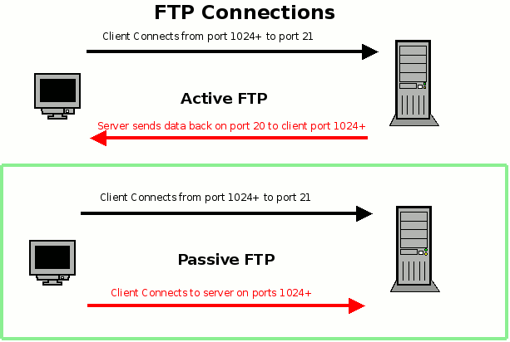
FTP Model Diagram

Slide 37
Active FTP:
The FTP client first establishes a connection with the TCP 21 port of the server to send commands. When the client needs to receive data, it sends PORT commands on this channel. The PORT command contains what port the client receives data from. When transmitting data, the server connects to the specified port of the client through its own TCP 20 port to send data. FTP server must establish a new connection with the client to transfer data.
Passive FTP:
Establishing control channels is similar to Stand mode, but Pasv commands are sent after establishing connections. When the server receives the Pasv command, it opens a temporary port (port number is greater than 1023 and less than 65535) and notifies the client of the request to transmit data on this port. The client connects to the FTP server on this port, and then the FTP server transmits data through this port.

Slide 38
BOOLAPI FtpGetFileA(
HINTERNET hConnect,
LPCSTR lpszRemoteFile,
LPCSTR lpszNewFile,
BOOL fFailIfExists,
DWORD dwFlagsAndAttributes,
DWORD dwFlags,
DWORD_PTR dwContext
);
FtpGetFileA: Retrieves a file from the FTP server and stores it under the specified file name, creating a new local file in the process.
hConnect: Handle to an FTP session.
lpszRemoteFile: Pointer to a null-terminated string that contains the name of the file to be retrieved.
lpszNewFile: Pointer to a null-terminated string that contains the name of the file to be created on the local system.
fFailIfExists: Indicates whether the function should proceed if a local file of the specified name already exists. If fFailIfExists is TRUE and the local file exists, FtpGetFile fails.

Slide 39
dwFlagsAndAttributes: File attributes for the new file.
dwFlags: Controls how the function will handle the file download(ASCII or Binary).
void FtpOpenFileA(
HINTERNET hConnect,
LPCSTR lpszFileName,
DWORD dwAccess,
DWORD dwFlags,
DWORD_PTR dwContext
);
FtpOpenFileA: Initiates access to a remote file on an FTP server for reading or writing.
hConnect: Handle to an FTP session.
lpszFileName: Pointer to a null-terminated string that contains the name of the file to be accessed.
dwAccess: File access. This parameter can be GENERIC_READ or GENERIC_WRITE, but not both.

Slide 40
dwFlags: Conditions under which the transfers occur. The application should select one transfer type and any of the flags that indicate how the caching of the file will be controlled.
dwContext: Pointer to a variable that contains the application-defined value that associates this search with any application data.
BOOLAPI FtpPutFileA(
HINTERNET hConnect,
LPCSTR lpszLocalFile,
LPCSTR lpszNewRemoteFile,
DWORD dwFlags,
DWORD_PTR dwContext
);
FtpPutFileA: Stores a file on the FTP server.
hConnect: Handle to an FTP session.
lpszLocalFile: The name of the file to be sent from the local system.

Slide 41
lpszNewRemoteFile: The name of the file to be created on the remote system.
dwFlags: Conditions under which the transfers occur.
Example:ftp文件下载器

Slide 42
System Services Development

Slide 43
Memory Management API
As an important technology of storage management in modern operating system, virtual memory has realized the function of memory expansion. But the function is not to expand the memory capacity physically, but to expand the memory capacity logically, which makes the user feel that the memory capacity is much larger than the actual memory capacity. So you can run programs that are more than memory space, or more user programs that run concurrently.

Slide 44
Paging storage management:
Paging is a memory management technique in which process address space is broken into blocks of the same size called pages The size of the process is measured in the number of pages.
Pages and physical blocks: Page. Paging storage management divides the process's logical address space into several pages and numbers them. Correspondingly, the physical address space is also divided into several blocks and numbered for them. When allocating memory for a process, several pages of the process are loaded into physical blocks that can not be adjacent to each other in blocks.
Page table: In order to find the corresponding physical memory block in memory. The system creates an image table for each process, referred to as a page table.

Slide 45
Page State:
Free: The page is neither committed nor reserved. The page is not accessible to the process. It is available to be reserved, committed, or simultaneously reserved and committed. Attempting to read from or write to a free page results in an access violation exception.
Reserved: The page has been reserved for future use. The range of addresses cannot be used by other allocation functions. The page is not accessible and has no physical storage associated with it. It is available to be committed.
Committed: Memory charges have been allocated from the overall size of RAM and paging files on disk. The page is accessible and access is controlled by one of the memory protection constants. The system initializes and loads each committed page into physical memory only during the first attempt to read or write to that page. When the process terminates, the system releases the storage for committed pages.

Slide 46
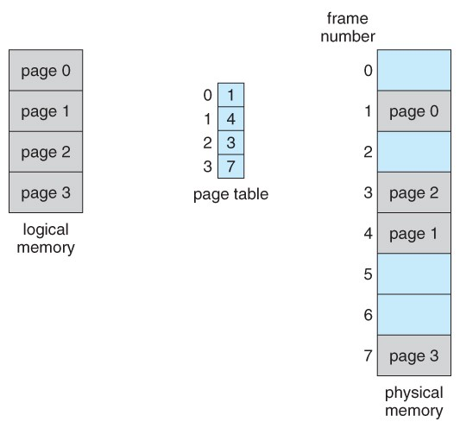
Paging management diagrams

Slide 47
Locality principle:
In a short period of time, the execution of the program is limited to a certain part, and correspondingly, the storage space it accesses is limited to a certain region. Locality is usually manifested in the following two aspects:
1) temporal locality: If an instruction is executed, it may be executed again soon. The typical reason for time limitation is that there are a lot of cyclic operations in the program.
2) spatial locality: Once a program accesses a storage unit, the nearby storage unit will also be accessed soon. Typical cases are sequential execution of programs.
Because of the principle of locality in program operation, we can load program and data locally to save memory space. So OS introduces the concept of virtual storage. When the program runs, if the pages it visits are already in memory, it can continue to execute; but if it is not in memory, it will issue page interrupt requests. At this time, OS will use the request paging function to transfer them into memory so that the program can continue to execute. If the memory is full and new pages cannot be loaded at this time, OS also needs to use the page replacement function to transfer temporarily unused pages in memory to disk. After making enough memory space, the pages to be visited will be transferred to memory so that the program can continue to execute.

Slide 48
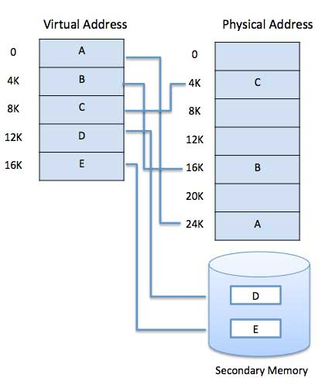
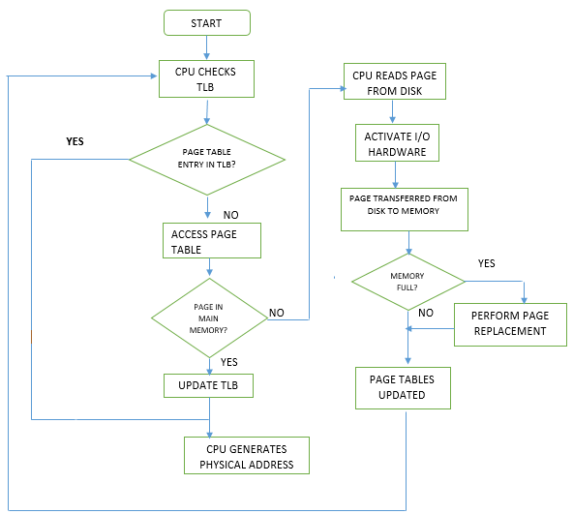
Virtual Address Space Diagram
Address transformation process

Slide 49
File Mapping:
File mapping is the association of a file's contents with a portion of the virtual address space of a process. The file mapping object can consist of all or only part of the file. It is backed by the file on disk. This means that when the system swaps out pages of the file mapping object, any changes made to the file mapping object are written to the file.
File view:
To map the data from a file to the virtual memory of a process, you must create a view of the file. A file view can consist of all or only part of the file mapping object. A process manipulates the file through the file views. A process can create multiple views for a file mapping object. The file views created by each process reside in the virtual address space of that process. When the process needs data from a portion of the file other than what is in the current file view, it can unmap the current file view, then create a new file view.

Slide 50
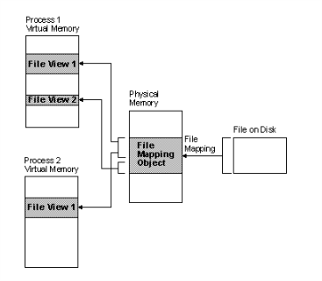
The relationship between the file on disk, a file mapping object, and a file view.
File mapping can be used to share a file or memory between two or more processes. To share a file or memory, all of the processes must use the name or the handle of the same file mapping object.

Slide 51
LPVOID VirtualAlloc(
LPVOID lpAddress,
SIZE_T dwSize,
DWORD flAllocationType,
DWORD flProtect
);
VirtualAlloc:Reserves, commits, or changes the state of a region of pages in the virtual address space of the calling process. Memory allocated by this function is automatically initialized to zero.
lpAddress:The starting address of the region to allocate.
dwSize:The size of the region, in bytes
flAllocationType:The type of memory allocation.(MEM_COMMIT, MEM_RESERVE)
flProtect:The memory protection for the region of pages to be allocated.(PAGE_EXECUTE_READ, PAGE_NOACCESS, PAGE_READWRITE)

Slide 52
BOOL VirtualFree(
LPVOID lpAddress,
SIZE_T dwSize,
DWORD dwFreeType
);
VirtualFree: Releases, decommits, or releases and decommits a region of pages within the virtual address space of the calling process.
lpAddress:A pointer to the base address of the region of pages to be freed.
dwSize:The size of the region of memory to be freed, in bytes.
dwFreeType: The type of free operation.(MEM_DECOMMIT, MEM_RELEASE)

Slide 53
HANDLE CreateFileMapping(
HANDLE hFile,
LPSECURITY_ATTRIBUTES lpFileMappingAttributes,
DWORD flProtect,
DWORD dwMaximumSizeHigh,
DWORD dwMaximumSizeLow,
LPCSTR lpName
);
CreateFileMapping: Creates or opens a named or unnamed file mapping object for a specified file.
hFile: A handle to the file from which to create a file mapping object.
flProtect: Specifies the page protection of the file mapping object.
dwMaximumSizeHigh: The high-order DWORD of the maximum size of the file mapping object.
dwMaximumSizeLow: The low-order DWORD of the maximum size of the file mapping object.
lpName: The name of the file mapping object.

Slide 54
LPVOID MapViewOfFile(
HANDLE hFileMappingObject,
DWORD dwDesiredAccess,
DWORD dwFileOffsetHigh,
DWORD dwFileOffsetLow,
SIZE_T dwNumberOfBytesToMap
);
hFileMappingObject: A handle to a file mapping object. The CreateFileMapping and OpenFileMapping functions return this handle.
dwDesiredAccess: The type of access to a file mapping object, which determines the page protection of the pages. (FILE_MAP_ALL_ACCESS, FILE_MAP_READ, FILE_MAP_WRITE)
dwFileOffsetHigh: A high-order DWORD of the file offset where the view begins.
dwFileOffsetLow: A low-order DWORD of the file offset where the view is to begin.
dwNumberOfBytesToMap: The number of bytes of a file mapping to map to the view.
Example:

Slide 55
Process And Thread
Process is the execution of a program and the basic unit of resource allocation and scheduling.
Threads are the smallest unit that the operating system can schedule operations. It is included in the process and is the actual unit of operation in the process.
A process can have multiple threads that share the resources of the process.
Threads have their own call stack and local storage.

Slide 56
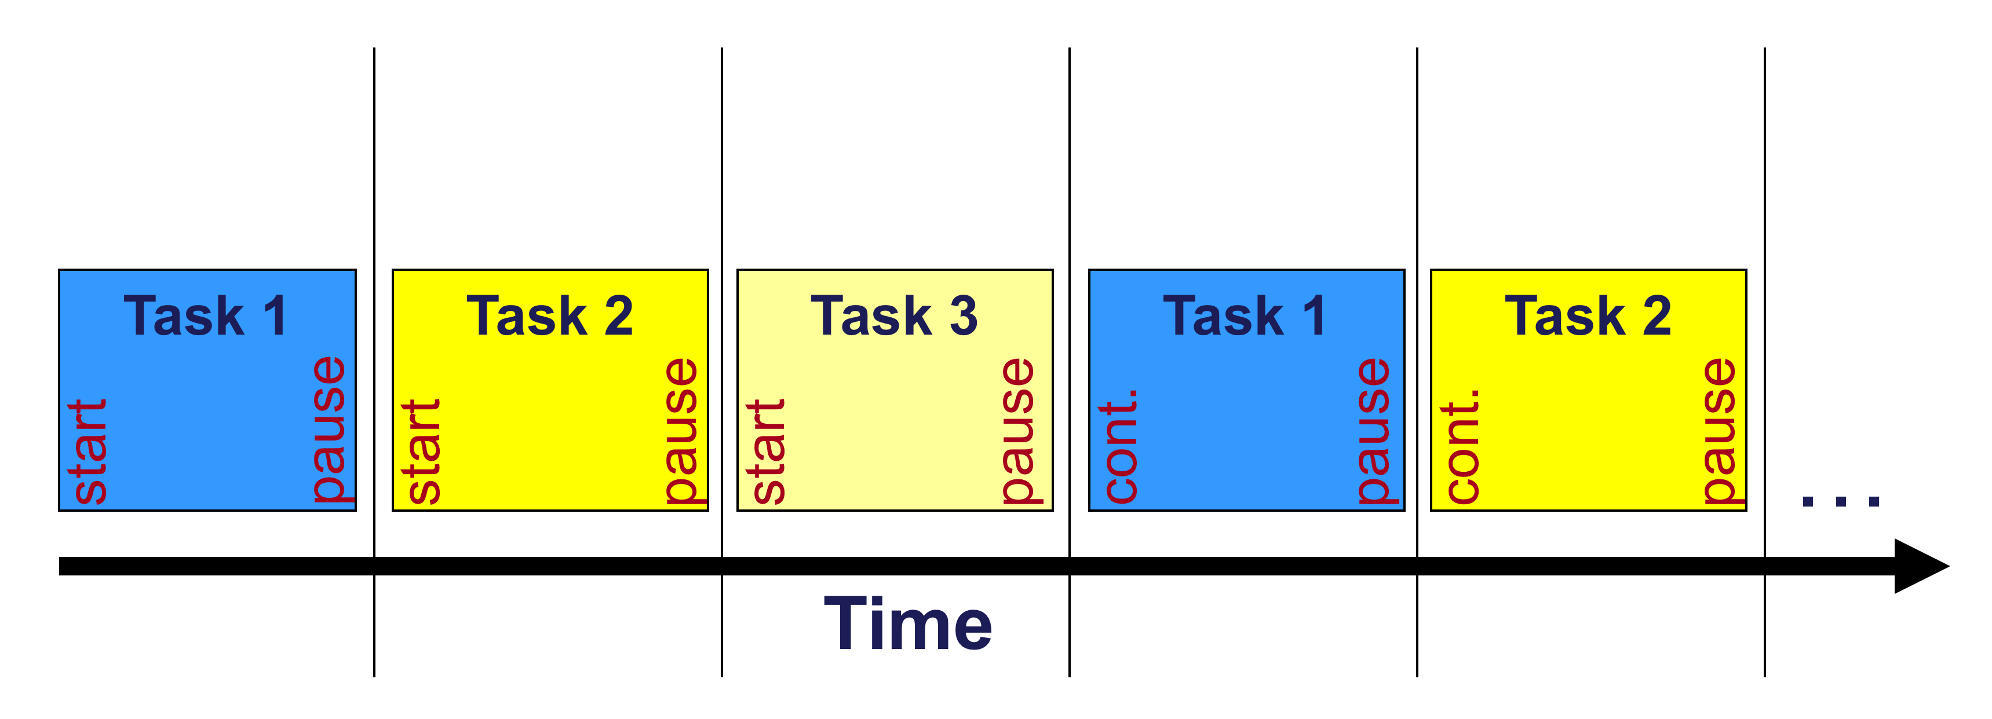
A multitasking operating system divides the available processor time among the processes or threads that need it. The system is designed for preemptive multitasking; it allocates a processor time slice to each thread it executes. The currently executing thread is suspended when its time slice elapses, allowing another thread to run. When the system switches from one thread to another, it saves the context of the preempted thread and restores the saved context of the next thread in the queue. The length of the time slice depends on the operating system and the processor.

Slide 57
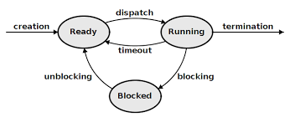
Ready: This means that the process is ready, that is, the process is allocated to all necessary resources except CPU.
Running: This refers to the state in which a process has acquired a CPU and its program is executing.
Block: The state in which the executing process is temporarily unable to continue because something has happened.
State transition of process

Slide 58
Synchronizing Execution of Multiple Threads
To avoid race conditions and deadlocks, it is necessary to synchronize access by multiple threads to shared resources. Synchronization is also necessary to ensure that interdependent code is executed in the proper sequence.
There are a number of objects whose handles can be used to synchronize multiple threads. These objects include:
Timers
Events
Mutexes
Processes
Semaphores
Threads
Console input buffers
The state of each of these objects is either signaled or not signaled. When you specify a handle to any of these objects in a call to one of the wait functions, the execution of the calling thread is blocked until the state of the specified object becomes signaled.

Slide 59
HANDLE CreateThread(
LPSECURITY_ATTRIBUTES lpThreadAttributes,
SIZE_T dwStackSize,
LPTHREAD_START_ROUTINE lpStartAddress,
__drv_aliasesMem LPVOID lpParameter,
DWORD dwCreationFlags,
LPDWORD lpThreadId
);
CreateThread: Creates a thread to execute within the virtual address space of the calling process.
lpThreadAttributes: A pointer to a SECURITY_ATTRIBUTES structure that determines whether the returned handle can be inherited by child processes.
dwStackSize : The initial size of the stack, in bytes. The system rounds this value to the nearest page.
lpStartAddress: A pointer to the application-defined function to be executed by the thread.
lpParameter: A pointer to a variable to be passed to the thread.
dwCreationFlags: The flags that control the creation of the thread.(0 stands for immediate operation, CREATE_SUSPENDED)
lpThreadId: A pointer to a variable that receives the thread identifier.

Slide 60
DWORD WaitForSingleObject(
HANDLE hHandle,
DWORD dwMilliseconds
);
WaitForSingleObject: Waits until the specified object is in the signaled state or the time-out interval elapses.
hHandle: A handle to the object. (Event, Mutex, Process, Thread, Waitable timer, etc.)
dwMilliseconds: The time-out interval, in milliseconds.
HANDLE CreateMutex(
LPSECURITY_ATTRIBUTES lpMutexAttributes,
BOOL bInitialOwner,
LPCSTR lpName
);
CreateMutex: A pointer to a SECURITY_ATTRIBUTES structure. If this parameter is NULL, the handle cannot be inherited by child processes.

Slide 61
bInitialOwner: If this value is TRUE and the caller created the mutex, the calling thread obtains initial ownership of the mutex object. Otherwise, the calling thread does not obtain ownership of the mutex.
lpName: The name of the mutex object. The name is limited to MAX_PATH characters. Name comparison is case sensitive.
BOOL ReleaseMutex(
HANDLE hMutex
);
ReleaseMutex: A handle to the mutex object.
Example:线程同步

Slide 62
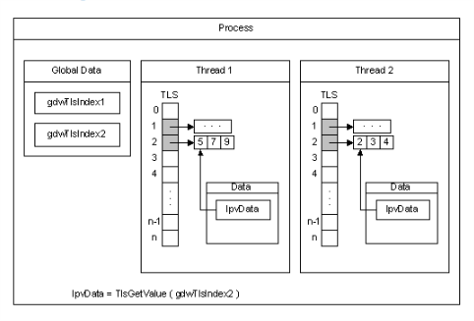
Thread Local Storage：
All threads of a process share its virtual address space. The local variables of a function are unique to each thread that runs the function. However, the static and global variables are shared by all threads in the process. With thread local storage (TLS), you can provide unique data for each thread that the process can access using a global index. One thread allocates the index, which can be used by the other threads to retrieve the unique data associated with the index.

Slide 63
DWORD TlsAlloc(
);
TlsAlloc: If the function succeeds, the return value is a TLS index. The slots for the index are initialized to zero.
BOOL TlsSetValue(
DWORD dwTlsIndex,
LPVOID lpTlsValue
);
TlsSetValue: Stores a value in the calling thread's thread local storage (TLS) slot for the specified TLS index.
dwTlsIndex: The TLS index that was allocated by the TlsAlloc function.
lpTlsValue: The value to be stored in the calling thread's TLS slot for the index.

Slide 64
LPVOID TlsGetValue(
DWORD dwTlsIndex
);
TlsGetValue: Retrieves the value in the calling thread's thread local storage (TLS) slot for the specified TLS index.
dwTlsIndex: The TLS index that was allocated by the TlsAlloc function.
If the function succeeds, the return value is the value stored in the calling thread's TLS slot associated with the specified index.
Example:线程本地存储

Slide 65
Process communication：
1)Shared-Memory System: Intercommunicating processes share certain data structures or shared storage areas through which processes can communicate.
2)Pipe: A pipe is a section of shared memory that processes use for communication. The process that creates a pipe is the pipe server. A process that connects to a pipe is a pipe client. One process writes information to the pipe, then the other process reads the information from the pipe.
3)Client-Server System: Socket is a common way of network process communication. It contains the destination address, port number, transport layer protocol, and other information of communication.

Slide 66
BOOL WINAPI CreatePipe(
_Out_ PHANDLE hReadPipe,
_Out_ PHANDLE hWritePipe,
_In_opt_ LPSECURITY_ATTRIBUTES lpPipeAttributes,
_In_ DWORD nSize
);
CreatePipe: Creates an anonymous pipe, and returns handles to the read and write ends of the pipe.
hReadPipe: A pointer to a variable that receives the read handle for the pipe.
hWritePipe: A pointer to a variable that receives the write handle for the pipe.
lpPipeAttributes: A pointer to a SECURITY_ATTRIBUTES structure that determines whether the returned handle can be inherited by child processes. If lpPipeAttributes is NULL, the handle cannot be inherited.
nSize: The size of the buffer for the pipe, in bytes. The size is only a suggestion; the system uses the value to calculate an appropriate buffering mechanism. If this parameter is zero, the system uses the default buffer size.
Example: 管道通信

Slide 67
File And Storage
Due to the limitation of memory size and the volatility of stored information in memory (program termination or power failure, the information stored by the program will also not exist). There are three requirements for file storage:
1. Can store a lot of information.
2. Information still exists when the process terminates.
3. Multiple processes must be able to access information concurrently.

Slide 68
File is the information logic unit created by the process, and each file is independent of other files. The essence of a file is an address space. The difference is that the file is an abstraction of the disk, not RAM.
Common file structures:
Byte Sequence: Considering a file as a byte sequence can provide maximum flexibility for the operating system. User programs can add anything to a file and name it in any convenient form.
Record Sequence: A file is a sequence with fixed length records, each record has its internal structure.
File type:
Regular files: Documents containing user information are divided into ASCII files and binary files.
Directory: A directory is a system file with a file system structure.
Special File: Specially refers to the I/O device in the system.

Slide 69
File operation:
Create: Create a file that does not contain any data. The purpose of this call is to indicate the establishment of the file and to set some properties of the file.
Delete: When a file is no longer needed, delete the file to free up the disk space occupied by the file.
Open: Load file attributes and disk address tables into memory for subsequent calls.
Close: In contrast to open, remove unwanted file attributes and disk address tables from memory.
Read: Read data from a file.
Write: Write data to a file.
Seek: For random access to files, set file pointers.

Slide 70
How file are organized on disk
Continuous allocation: Storing file data on a set of adjacent disks. Continuous allocation has higher read performance, because the system can find the first disk number of the file from the directory, and then read it down sequentially. Continuous allocation also supports random access. But with the passage of time, there will be a lot of debris and waste of space.
Link list allocation: Each disk block of the storage file has a pointer to the next disk, so that the discrete storage of the file can be realized. Reduce disk fragmentation. However, because each disk block needs a space to store pointers, it also incurs additional overhead, and random access is inefficient.
Link list allocation using File Allocation Table: Take out the pointer of each disk block and put it into a table in memory. In this way, although random access still needs to follow the list query, but because it is read and write in memory (no device I/O) so the speed is much faster than the previous method.

Slide 71
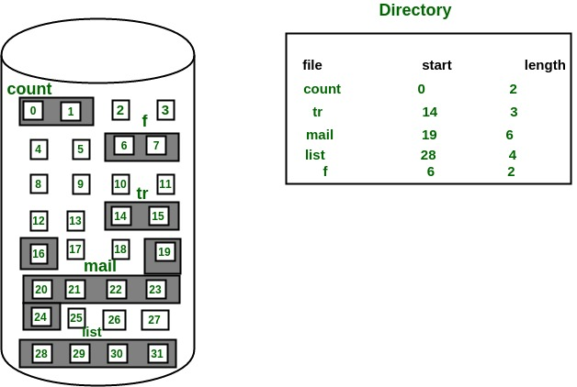
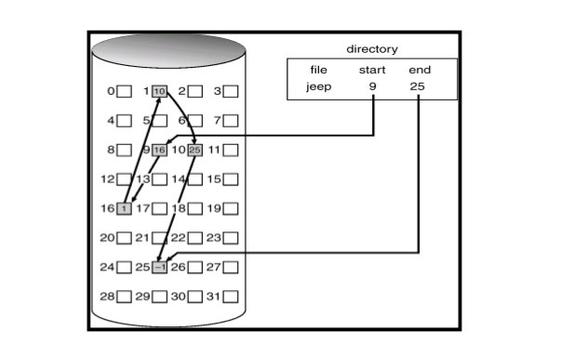
Continuous allocation
Link list allocation

Slide 72
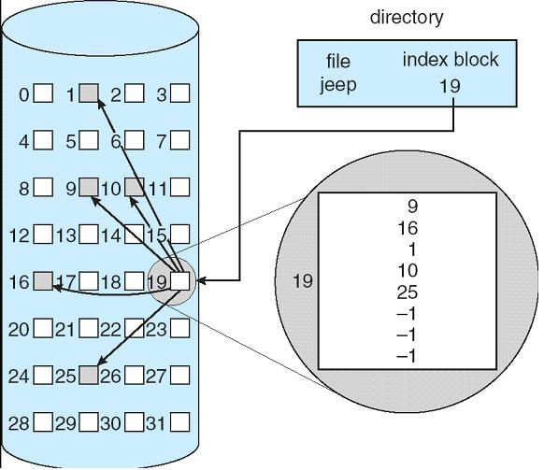
Link list allocation using File Allocation Table

Slide 73
Disk Space Management
Free Link List Method: Use a linked list to store all free disk block numbers. When a file is created, the pointer is removed from the list, disk space is released when the file is deleted, and the pointer is put into the list.
Bitmap Method: This method uses binary to represent the disk usage, when the flag is 1, the disk is used, and 0 is free. All disks form a set. Usually it can be described as a matrix of m*n. M*n is the total number of disks.

Slide 74
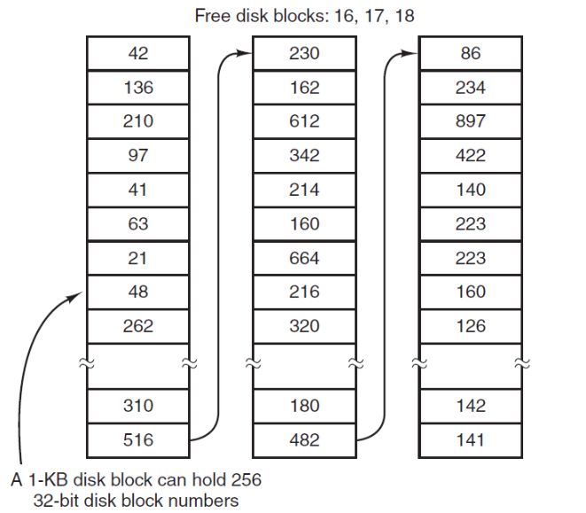
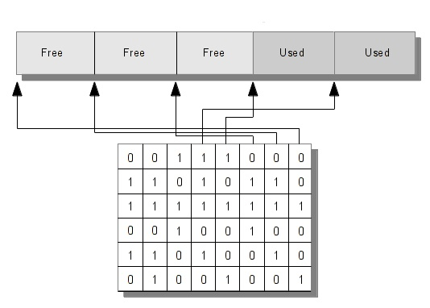
Free Link List Method
Bitmap Method

Slide 75
HANDLE CreateFile(
LPCSTR lpFileName,
DWORD dwDesiredAccess,
DWORD dwShareMode,
LPSECURITY_ATTRIBUTES lpSecurityAttributes,
DWORD dwCreationDisposition,
DWORD dwFlagsAndAttributes,
HANDLE hTemplateFile
);
CreateFile: Creates or opens a file or I/O device.
lpFileName: The name of the file or device to be created or opened
dwDesiredAccess: Setting Access Permissions
dwShareMode: Specify sharing mode.
lpSecurityAttributes: Specify security attributes.
dwCreationDisposition: Indicates how to open.

Slide 76
dwFlagsAndAttributes : The file or device attributes and flags, FILE_ATTRIBUTE_NORMAL being the most common default value for files.
hTemplateFile: A valid handle to a template file with the GENERIC_READ access right.
BOOL CopyFile(
LPCTSTR lpExistingFileName,
LPCTSTR lpNewFileName,
BOOL bFailIfExists
);
CopyFile: Copies an existing file to a new file.
lpExistingFileName: The name of an existing file.
lpNewFileName: The name of the new file.
bFailIfExists: If this parameter is TRUE and the new file specified by lpNewFileName already exists, the function fails. If this parameter is FALSE and the new file already exists, the function overwrites the existing file and succeeds.

Slide 77
BOOL DeleteFile(
LPCSTR lpFileName
);
DeleteFile: Deletes an existing file.
lpFileName: The name of the file to be deleted.
BOOL ReadFile(
HANDLE hFile,
LPVOID lpBuffer,
DWORD nNumberOfBytesToRead,
LPDWORD lpNumberOfBytesRead,
LPOVERLAPPED lpOverlapped
);
ReadFile: Reads data from the specified file or input/output (I/O) device.
hFile: A handle to the device.
lpBuffer: Receiving Data Buffer.

Slide 78
nNumberOfBytesToRead: The maximum number of bytes to be read.
lpNumberOfBytesRead: A pointer to the variable that receives the number of bytes read when using a synchronous hFile parameter.
lpOverlapped: A pointer to an OVERLAPPED structure is required if the hFile parameter was opened with FILE_FLAG_OVERLAPPED, otherwise it can be NULL.
BOOL WriteFile(
HANDLE hFile,
LPCVOID lpBuffer,
DWORD nNumberOfBytesToWrite,
LPDWORD lpNumberOfBytesWritten,
LPOVERLAPPED lpOverlapped
);
WriteFile: Writes data to the specified file or input/output (I/O) device.
hFile: A handle to the file or I/O device .
lpBuffer: A pointer to the buffer containing the data to be written to the file or device.
nNumberOfBytesToWrite: The number of bytes to be written to the file or device.

Slide 79
nNumberOfBytesToWrite : The number of bytes to be written to the file or device.
lpNumberOfBytesWritten: A pointer to the variable that receives the number of bytes written when using a synchronous hFile parameter.
lpOverlapped: A pointer to an OVERLAPPED structure is required if the hFile parameter was opened with FILE_FLAG_OVERLAPPED, otherwise this parameter can be NULL.
DWORD SetFilePointer(
HANDLE hFile,
LONG lDistanceToMove,
PLONG lpDistanceToMoveHigh,
DWORD dwMoveMethod
);
SetFilePointer: Moves the file pointer of the specified file.
hFile: A handle to the file.
lDistanceToMove: The low order 32-bits of a signed value that specifies the number of bytes to move the file pointer.
lpDistanceToMoveHigh: A pointer to the high order 32-bits of the signed 64-bit distance to move.
dwMoveMethod: The starting point for the file pointer move.

Slide 80
BOOL LockFile(
HANDLE hFile,
DWORD dwFileOffsetLow,
DWORD dwFileOffsetHigh,
DWORD nNumberOfBytesToLockLow,
DWORD nNumberOfBytesToLockHigh
);
LockFile: Locks the specified file for exclusive access by the calling process.
BOOL UnlockFile(
HANDLE hFile,
DWORD dwFileOffsetLow,
DWORD dwFileOffsetHigh,
DWORD nNumberOfBytesToUnlockLow,
DWORD nNumberOfBytesToUnlockHigh
);
UnlockFile: Unlocking a region enables other processes to access the region.
Example:文件

Slide 81
Thanks!

